Slide 1

DOM and Events
DOM API. Targeting, Creating & Manipulating Elements. Handling Events
SoftUni Team
Technical Trainers
Software University
https://softuni.bg

Slide 2
Table of Contents
The DOM API
Targeting & Selecting Elements
Creating & Manipulating Elements
Handling Events
2
Notes:
2

Slide 3
Have a Question?
sli.do
#js-front-end
Notes:
3

Slide 4
DOM API
Document Object Model

Slide 5
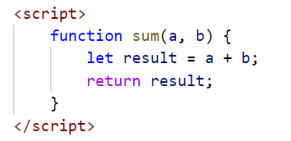
JavaScript in the Browser
Code can be executed in the page in different ways:
Directly in the developer console – when debugging
As a page event handler – e.g., user clicks on a button
Via inline script, using <script> tags
By importing from external file – most flexible method

Slide 6

Document Object Model
The DOM represents the document as nodes and objects
That way, the programming languages can connect to the page
The HTML DOM is an Object Model for HTML. It defines:
HTML elements as objects
Properties
Methods
Events

Slide 7
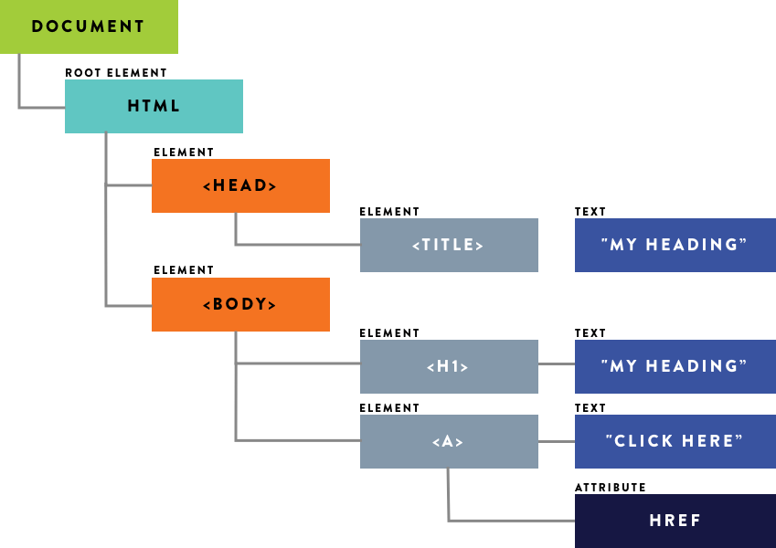
From HTML to DOM Tree
The browser parses HTML and creates a DOM Tree
The elements are nested in each other and create a hierarchy
Like the hierarchy of a street address – Country, City, Street, etc.
<html>
<head>
<title>My Heading</title>
</head>
<body>
<h1>My Heading</h1>
<a href="/about">Click Here</a>
</body>
</html>

Slide 8
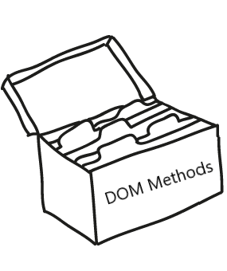
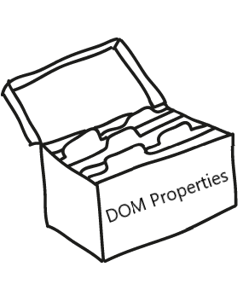
DOM Methods
DOM Methods - actions you can perform on HTML elements
DOM Properties - values of HTML elements that you can set or change

Slide 9
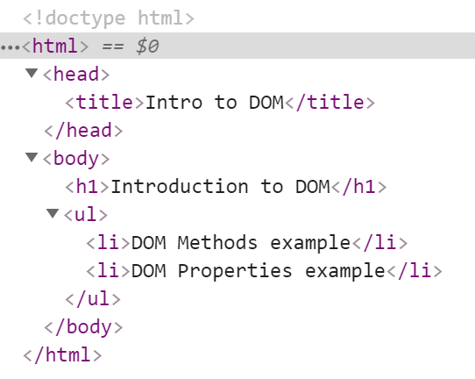



Example: DOM Methods
HTML DOM method is an action you can do (like add or delete an HTML element)

Slide 10
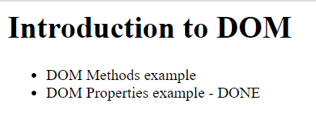
Example: DOM Methods
HTML DOM property is a value that you can get or set (changing the content of an HTML element)

Slide 11
Using the DOM API
JavaScript can interact with web pages via the DOM API:
Check the contents and structure of elements on the page
Modify element style and properties
Read user input and react to events
Create and remove elements
Most actions are performed when an event occurs
Events are "fired" when something of interest happens
All of this and more will be examined in upcoming lessons

Slide 12
Elements and Properties
The DOM Tree is comprised of HTML elements
Elements are JS objects with properties and methods
They can be accessed and modified like regular objects
To change the contents of the page:
Select an element to obtain a reference
Modify its properties

Slide 13
Attributes and Properties
Attributes are defined by HTML
Attributes initialize DOM properties
Property values can change via the DOM API
The HTML attribute and the DOM property are technically not the same thing
Since the outcome is the same, in practice you will almost never encounter a difference!

Slide 14

DOM Manipulations
The HTML DOM allows JavaScript to change the content of HTML elements
innerHTML
textContent
value
style
And many others to be discussed in upcoming lessons

Slide 15
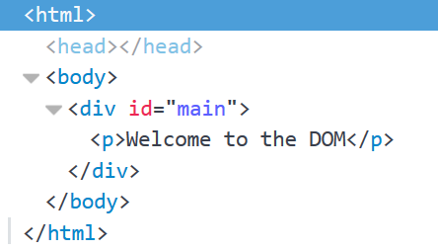
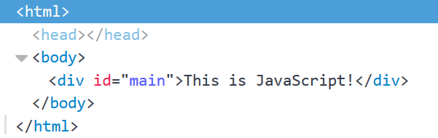
Accessing Element HTML
To access raw HTML:
This will be parsed – beware of XSS attacks!
Changing textContent or innerHTML removes all child nodes
element.innerHTML = "<p>Welcome to the DOM</p>";

Slide 16
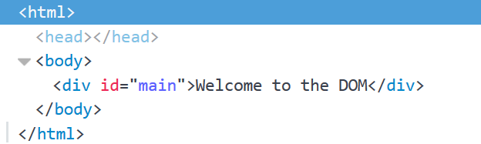
Accessing Element Text
The contents of HTML elements are stored in text nodes
To access the contents of an element:
If the element has children, returns all text concatenated
let text = element.textContent; //This is JavaScript!
element.textContent = "Welcome to the DOM";

Slide 17
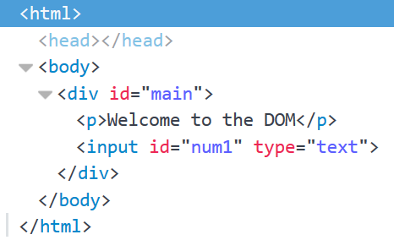
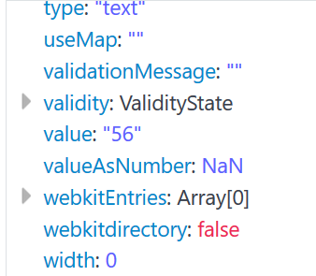
Accessing Element Values
The values of input elements are string properties on them:
let num = Number(element.value);
element.value = 56;

Slide 18
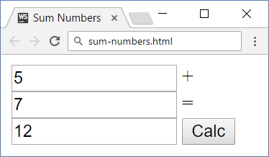
Problem: Sum Numbers
Write a JS function to sum two numbers (fill the missing code)
<input type="text" id="num1" /> +
<input type="text" id="num2" /> =
<input type="text" id="sum" readonly="readonly" />
<input type="button" value="Calc" onclick="calc()" />
<script src="calc.js"></script>
calc.js
function calc() {
// TODO
}

Slide 19
Solution: Sum Numbers
function calc() {
let num1 = document.getElementById('num1').value;
let num2 = document.getElementById('num2').value;
let sum = Number(num1) + Number(num2);
document.getElementById('sum').value = sum;
}
Check your solution here: https://judge.softuni.org/Contests/Compete/Index/3794#0

Slide 20
Control Content via Visibility
Content can be hidden or revealed by changing its display style
This is a common technique to display content dynamically
To hide an element:
To reveal an element, set display to anything that isn't 'none' (including empty string)
const element = document.getElementById('main');
element.style.display = 'none';
element.style.display = ''; // Can be 'inline', 'block', etc.

Slide 21
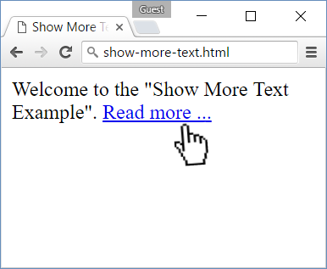
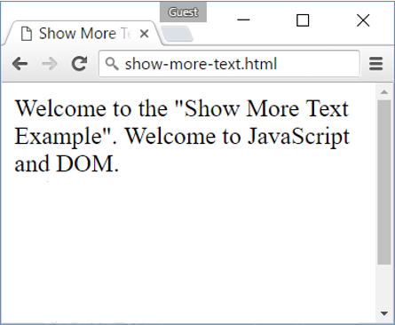
Problem: Show More Text
A HTML page holds a short text + link "Read more …"
Clicking on the link shows more text and hides the link

Slide 22
Problem: Show More Text – HTML
Welcome to the "Show More Text Example".
<a href="#" id="more" onclick= "showText()">Read more …</a>
<span id="text" style= "display:none">Welcome to …</span>
<script>
function showText() {
// TODO
}
</script>
See the DOM tree here: http://software.hixie.ch/utilities/js/live-dom-viewer/?saved=4275

Slide 23

Targeting & Selecting Elements
Id, Class, Tag and Query Selectors

Slide 24
Targeting Elements
There are a few ways to find a certain HTML element in the DOM:
By ID - getElementById()
By class name - getElementsByClassName()
By tag name - getElementsByTagName()
By CSS selector - querySelector(), querySelectorAll()
These methods return a reference to the element, which can be manipulated with JavaScript

Slide 25
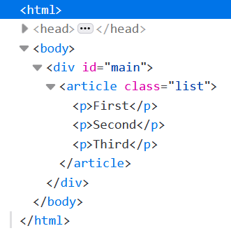
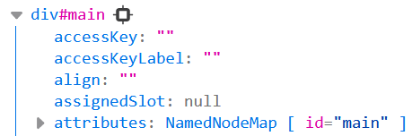
Targeting by ID - Example
The ID attribute must be unique on the page
const element = document.getElementById('main');
console.log(element);

Slide 26
Targeting by Tag and Class Names – Example
The tag name specifies the type of element – div, p, ul, etc.
Class names are used for styling and easier selection
Both methods return a live HTMLCollection
Even if only one element is selected! This is a common mistake
const elements = document.getElementsByTagName('p');
// Select all paragraphs on the page
const elements = document.getElementsByClassName('list');
// Select all elements having a class named 'list'

Slide 27
Query Selectors - Example
Select the first matching element
Select all matching elements
Returns a static NodeList
const mainDiv = document.querySelector('#main');
// Select the element with ID 'main'
const element = document.querySelector('p');
// Select the first paragraph on the page
const elements = document.querySelectorAll('article.list');
// Select all <article> elements having a class named 'list'

Slide 28
NodeList vs. HTMLCollection
Both interfaces are collections of DOM nodes
NodeList can contain any node type, including text and whitespace
HTMLCollection contains only Element nodes
Both have iteration methods, HTMLCollection has an extra namedItem method
HTMLCollection is live, while NodeList can be either live or static

Slide 29
Iterating Element Collections
NodeList and HTMLCollection are NOT arrays but can be indexed and iterated
Both can be explicitly converted to an array
const elements = document.querySelectorAll('p');
const first = elements[0];
// Select the first paragraph on the page
for (let p of elements) { /* … */ }
// Iterate over all entries
const elementArray = Array.from(elements);
const elementArr2 = [...elements]; // Spread syntax

Slide 30
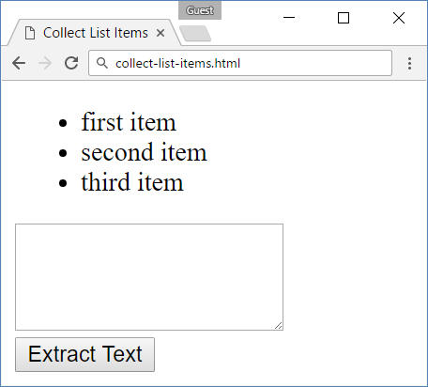
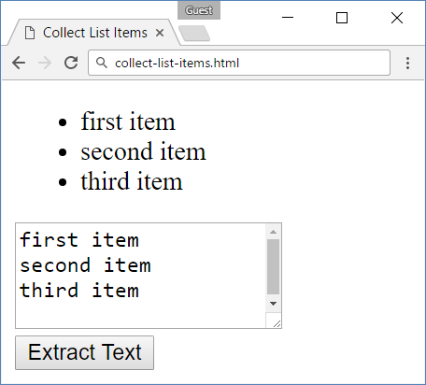
Problem: Collect List Items
Collect the list items from given HTML list and append their text to given text area

Slide 31
Problem: Collect List Items – HTML
<ul id="items">
<li>first item</li>
<li>second item</li>
<li>third item</li>
</ul>
<textarea id="result"> </textarea>
<br>
<button onclick="extractText()"> Extract Text</button>

Slide 32
Solution: Collect List Items
function extractText() {
let itemNodes =
document.querySelectorAll("ul#items li");
let textarea =
document.querySelector("#result");
for (let node of itemNodes) {
textarea.value += node.textContent + "\n";
}
}
Check your solution here: https://judge.softuni.org/Contests/Compete/Index/3794#2

Slide 33

DOM Manipulation
Parents & Children. CRUD Operations.

Slide 34
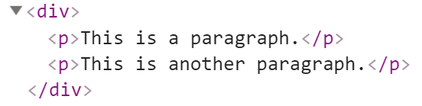

Parents and Child Elements
Every DOM Element has a parent
Parents can be accessed by property parentElement or parentNode
Accessing the first child
let firstP = document.getElementsByTagName('p')[0];
console.log(firstP.parentElement);
Accessing the child's parent

Slide 35
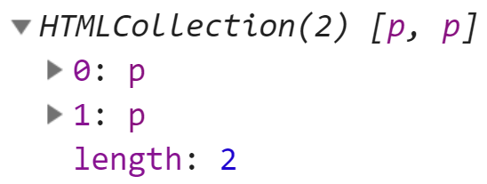
Parents and Child Elements
When some element contains other elements, that means he is parent of those elements
They are children to the parent. They can be accessed by property children
let pElements = document.getElementsByTagName('div')[0].children;
Returns live HTMLCollection

Slide 36

DOM Manipulations
We can create, append and remove HTML elements dynamically
appendChild()
removeChild()
replaceChild()

Slide 37
Creating New DOM Elements
HTML elements are created with document.createElement
Variables holding HTML elements are live:
If you modify the contents of the variable, the DOM is updated
If you insert it somewhere in the DOM, the original is moved
Text added to textContent will be escaped
Text added to innerHTML will be parsed and turned into actual HTML elements → beware of XSS attacks!

Slide 38
Creating DOM Elements
Creating a new DOM element
Create a copy / cloning DOM element
Elements are created in memory – they don't exist on the page
To become visible, they must be appended to the DOM tree
let p = document.createElement("p");
let li = document.createElement("li");
Tag name
let li = document.getElementById("my-list");
let newLi = li.cloneNode(true);

Slide 39
Manipulating Node Hierarchy
appendChild - Adds a new child, as the last child
prepend - Adds a new child, as the first child
let p = document.createElement("p");
let li = document.createElement("li");
li.appendChild(p);
let ul = document.getElementById("my-list");
let li = document.createElement("li");
ul.prepend(li);

Slide 40
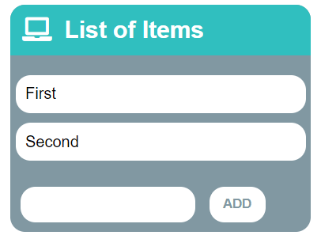
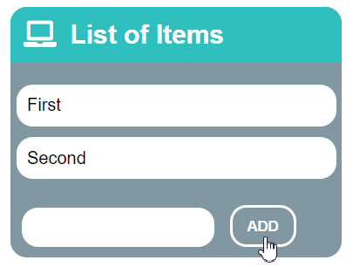
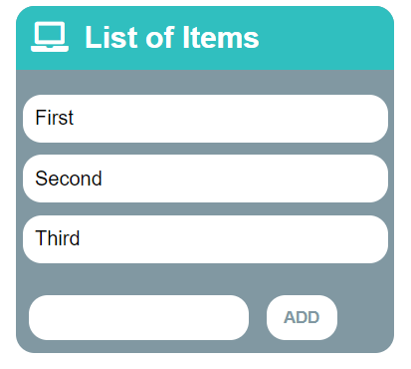
Problem: List of Items
Create a HTML page holding a list of items + text box + button for adding more items to the list
Write a function to append the specified text to the list

Slide 41
Problem: List of Items – HTML
<h1>List of Items</h1>
<ul id="items"><li>First</li><li>Second</li></ul>
<input type="text" id="newItemText" />
<input type="button" value="Add" onclick="addItem()">
<script>
function addItem() {
// TODO: Add new item to the list
}
</script>

Slide 42
Solution: List of Items
function addItem() {
let text = document.getElementById('newItemText').value;
let li = document.createElement("li");
li.appendChild(document.createTextNode(text));
document.getElementById("items").appendChild(li);
//clearing the input:
document.getElementById('newItemText').value = '';
}
Check your solution here: https://judge.softuni.org/Contests/Compete/Index/3794#3

Slide 43
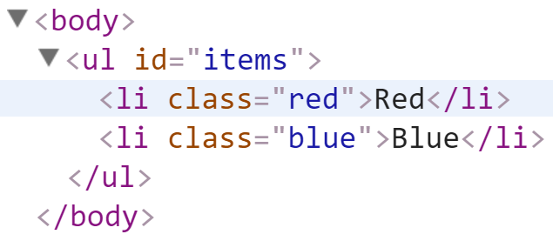
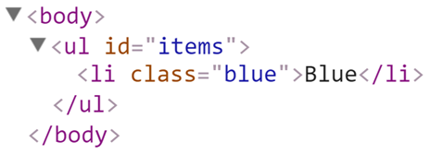
Deleting DOM Elements
<ul id="items">
<li class="red">Red</li>
<li class="blue">Blue</li>
</ul>
let redElements =
document.querySelectorAll("#items li.red");
redElements.forEach(li => {
li.parentNode.removeChild(li);
});

Slide 44
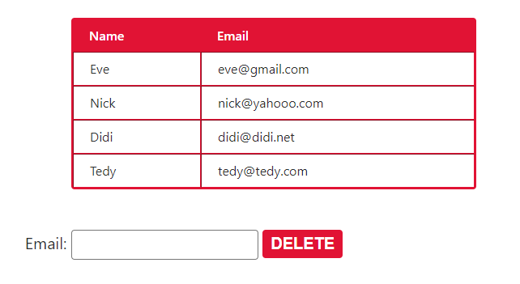
Problem: Delete from Table
<table border="1" id="customers">
<tr><th>Name</th><th>Email</th></tr>
<tr><td>Eve</td><td>eve@gmail.com</td></tr>
<tr><td>Nick</td><td>nick@yahooo.com</td></tr>
<tr><td>Didi</td><td>didi@didi.net</td></tr>
<tr><td>Tedy</td><td>tedy@tedy.com</td></tr>
</table>
Email: <input type="text" name="email" />
<button onclick="deleteByEmail()">Delete</button>
<div id="result" />

Slide 45
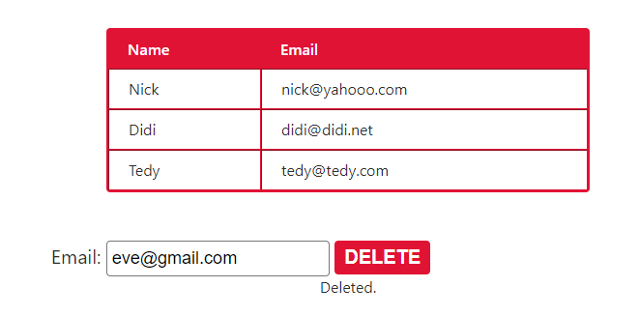
Solution: Delete from Table
function deleteByEmail() {
let email = document.getElementsByName("email")[0].value;
let secondColumn = document.querySelectorAll(
"#customers tr td:nth-child(2)");
for (let td of secondColumn)
if (td.textContent == email) {
let row = td.parentNode;
row.parentNode.removeChild(row);
document.getElementById('result').
textContent = "Deleted.";
return;
}
document.getElementById('result').textContent = "Not found.";
}
Check your solution here: https://judge.softuni.org/Contests/Compete/Index/3794#4

Slide 46

DOM Events
Event Types, Handling Events, Delegation

Slide 47
Event Types in DOM API
Mouse events
Touch events
DOM / UI events
click
mouseover mousmouseoutedown
mouseup
touchstart
touchend
touchmove
touchcancel
load
unload
resize
dragstart / drop
Keyboard events
Focus events
Form events
keydown
Keypress
keyup
input
change
submit
reset
focus (got focus)
blur (lost focus)

Slide 48
Event Handler
Event registration is done by providing a callback function
Three ways to register for an event:
With HTML Attributes
Using DOM element properties
Using DOM event handler – preferred method
function handler(event){ // this --> object, html reference
// event --> object, event configuration }

Slide 49

Event Listener
addEventListener();
removeEventListener();
htmlRef.addEventListener('click', handler , false);
htmlRef.removeEventListener('click', handler);

Slide 50
Attaching Click Handler
const button = document.getElementsByTagName('button')[0];
button.addEventListener('click', clickMe);
function clickMe(e) {
const target = e.currentTarget;
const targetText = target.textContent;
target.textContent = Number(targetText) + 1;
}

Slide 51
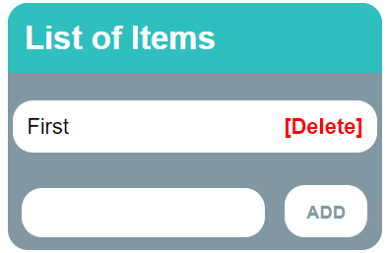
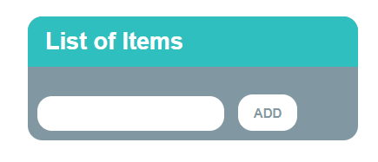
Problem: Add / Delete Items
Extend the previous problem
Implement [Delete] action as link after each list item

Slide 52
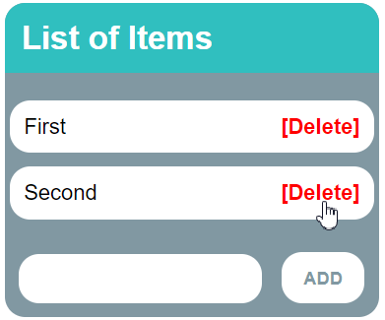
Problem: Add / Delete Items – HTML
<h1>List of Items</h1>
<ul id="items"></ul>
<input type="text" id="newText" />
<input type="button" value="Add" onclick="solve()">
<script>
function solve() { // TODO...
}
</script>

Slide 53
Solution: Add / Delete Items
function solve() {
let newElement = document.getElementById("newText").value;
let list = document.getElementById("items");
if (newElement.length === 0) return;
let listItem = document.createElement("li");
listItem.textContent = newElement;
let remove = document.createElement("a");
let linkText = document.createTextNode("[Delete]");
// Continued on the next slide ...

Slide 54
Solution: Add / Delete Items
remove.appendChild(linkText);
remove.href = "#";
remove.addEventListener("click", deleteItem);
listItem.appendChild(remove);
list.appendChild(listItem);
function deleteItem() {
listItem.remove();
}
}
Check your solution here: https://judge.softuni.org/Contests/Compete/Index/3794#5

Slide 55
Events Handler Execution Context
In event handlers, this refers to the event source element
Pay attention when using object methods as event listeners!
this may not behave as you expect with objects
element.addEventListener("click", function(e) {
console.log(this === e.currentTarget); // Always true
});

Slide 56

Summary
…
…
…
DOM – programming API for HTML documents
Selecting DOM Elements
By Id, By Class Name, By Tag Name
Query Selectors
The DOM Tree can be manipulated
Creating, Updating, Deleting Children/Parent Elements
DOM Events
Select Type & Handler Function

Slide 57
Questions?
Notes:
57

Slide 58














SoftUni Diamond Partners

Slide 59

Educational Partners

Slide 60

License
This course (slides, examples, demos, exercises, homework, documents, videos and other assets) is copyrighted content
Unauthorized copy, reproduction or use is illegal
© SoftUni – https://about.softuni.bg/
© Software University – https://softuni.bg
Notes:
60

Slide 61
Trainings @ Software University (SoftUni)
Software University – High-Quality Education, Profession and Job for Software Developers
softuni.bg, about.softuni.bg
Software University Foundation
softuni.foundation
Software University @ Facebook
facebook.com/SoftwareUniversity
Software University Forums
forum.softuni.bg
Notes:
61

